Slide 1







Corrupted GOOSE Detectors: Anomaly Detection in Power Utility Real-Time Ethernet Communications
Maëlle Kabir-Querrec
Stéphane Mocanu
Pascal Bellemain
Jean-Marc Thiriet
Eric Savary

Slide 2
Content
Introduction & objectives
Substation Automation System
  IEC 61850 architecture
  GOOSE protocol
Attack detection
  GOOSE attack resilient architecture
  Ethernet storm detection
  Corrupted GOOSE messages detection
GreHack 2015 11/20/2015 Maëlle Kabir-Querrec
2 / 11

Slide 3
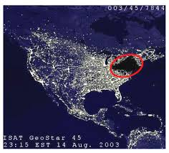
Introduction & Objectives
Introduction | SAS | Attack detection | Conclusion
2003 North America Blackout
Smart-grid → open & global networks
IEC 61850 standard → interoparability
"Communication networks and systems for power utility automation"
security through isolation
security through obscurity
Dedicated security measures are required!
GreHack 2015 11/20/2015 Maëlle Kabir-Querrec
3 / 11

Slide 4
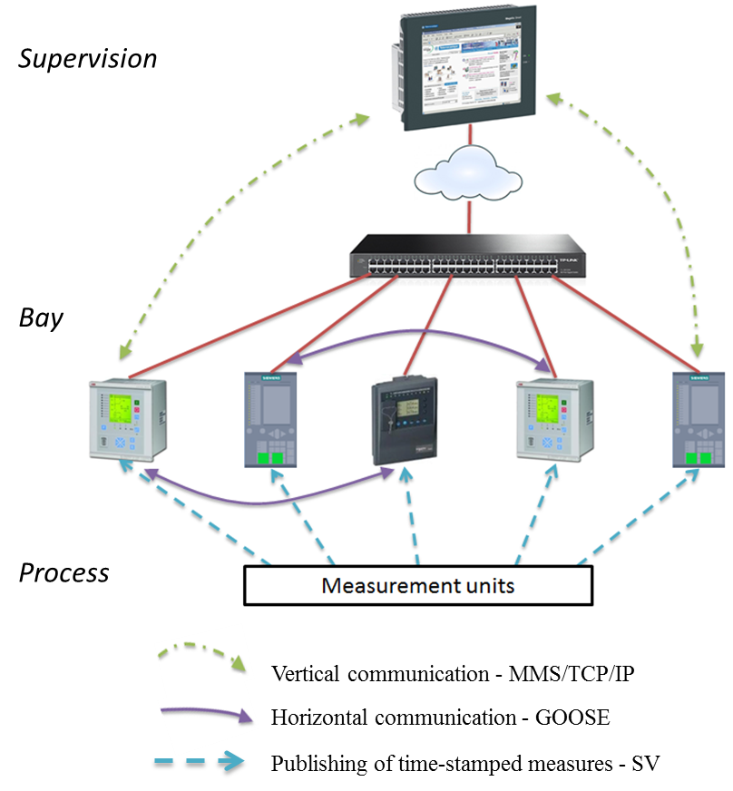
Substation Automation System - SAS
IEC 61850 communication architecture
Introduction | SAS | Attack detection | Conclusion
OSI mapping of IEC 61850 protocols
IEC 61850 communication architecture
GreHack 2015 11/20/2015 Maëlle Kabir-Querrec
4 / 11

Slide 5
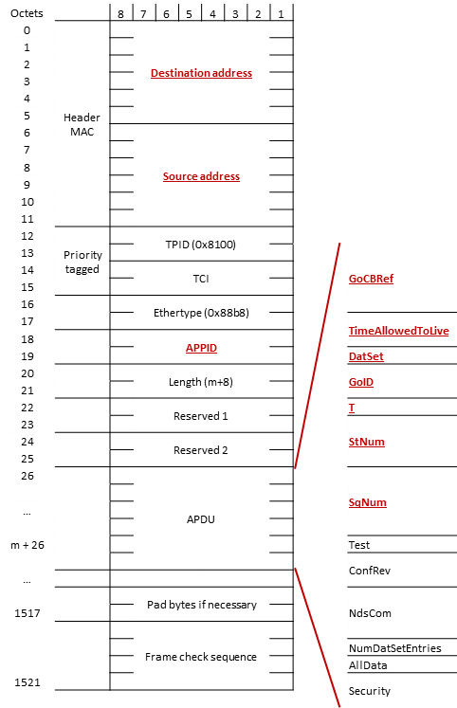
Substation Automation System - SAS
GOOSE protocol
Introduction | SAS | Attack detection | Conclusion
Transmission time
T0
(T0)
T1
T1
T2
T3
T0
event
T0 | retransmission in stable conditions (no event for a long time)
(T0) | retransmission in stable conditions may be shortened by an event
T1 | shortest retransmission time after an event
T2, T3 | longer retransmission times until achieving stable conditions
GOOSE transmission mechanism
Attacks:
Ethernet storm
Fraudulent GOOSE messages
GOOSE frame structure
GreHack 2015 11/20/2015 Maëlle Kabir-Querrec
5 / 11

Slide 6
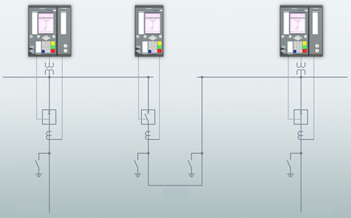
GOOSE attack detection
GOOSE attack resilient architecture
Introduction | SAS | Attack detection | Conclusion
SCADA
Ethernet IED-supervision
IED 1
IED
coupling
IED 2
Modbus
Request
section 1
section 2
Bandwidth checker
Alarm
Corrupted GOOSE detector
Ethernet IED-IED
supply 1
coupling
supply 2
Resilient communication architecture
GreHack 2015 11/20/2015 Maëlle Kabir-Querrec
6 / 11

Slide 7
GOOSE attack detection
Bandwidth checker
Introduction | SAS | Attack detection | Conclusion
From ifstat
Start ifstat in Modbus server mode
Initialize Modbus server
Wait for client connections
While (ifstat runs)
While (Client_Connection_Counter < Configured_Window)
Mean_Bandwidth += Number_of_IN_Frames_Since_Last_Connection / Configured_Window
Reset Client_Connection_Counter
Algo – bandwidth measurement
GreHack 2015 11/20/2015 Maëlle Kabir-Querrec
7 / 11

Slide 8
GOOSE attack detection
Corrupted GOOSE frame detector
Introduction | SAS | Attack detection | Conclusion
T₀
T₀
T₀
T₁
T₁
T₁
T₁
T₁
T₀
T₁
T₁
T₁
T₁
T₁
T₀
Attack – false GOOSE messages
Legitimate messages
Inconsistent Sequence numbers
Consecutive Sequence numbers
GOOSE attack timeline
GOOSE scapy master to:
sniff GOOSE messages,
decode them,
change a Boolean variable value in Data Set
modify StNum and SqNum appropriately,
encode fraudulent message,
send it.
Algo – fraudulent GOOSE message generator
GreHack 2015 11/20/2015 Maëlle Kabir-Querrec
8 / 11

Slide 9
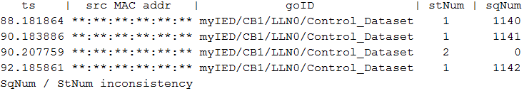
GOOSE attack detection
Corrupted GOOSE frame detector
Introduction | SAS | Attack detection | Conclusion
From tcpdump 4.7.4 / libpcap 1.7.4
Start tcpdump in Modbus server mode
Initialize Modbus server
While (tcpdump runs)
Get captured GOOSE message
Get RxTime
Get GOOSE PDU fields and store them
Check Source_Address
Check GoID
Check StNum and SqNum
Check RxTime
Algo – fraudulent GOOSE message detector
Legitimate message
Fraudulent message
Results from fraudulent GOOSE detector (GICS platform)
GreHack 2015 11/20/2015 Maëlle Kabir-Querrec
9 / 11

Slide 10
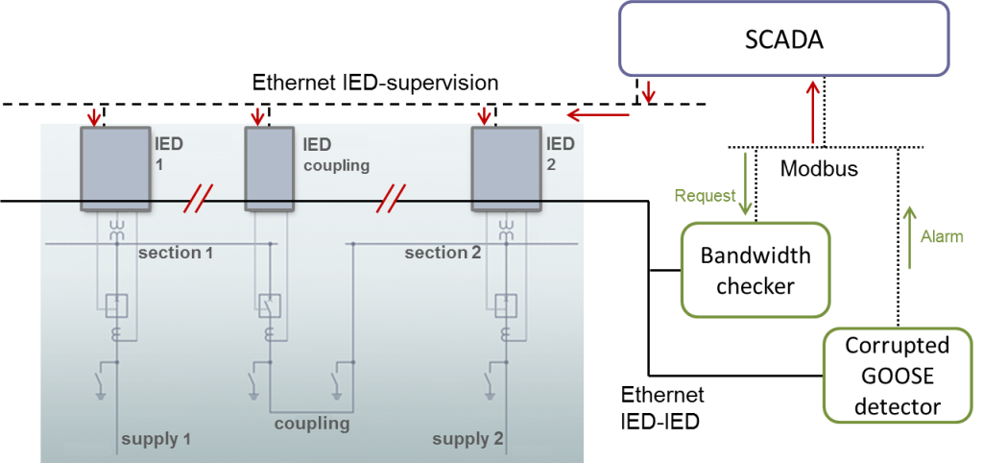
Conclusion & further work
Introduction | SAS | Attack detection | Conclusion
GOOSE traffic analyzer
The whole architecture is not completed yet.
GreHack 2015 11/20/2015 Maëlle Kabir-Querrec
10 / 11

Slide 11
Questions
& comments
GreHack 2015 11/20/2015 Maëlle Kabir-Querrec
11 / 11

